Slide 1














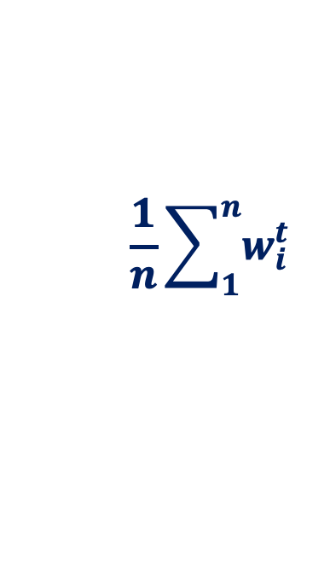




[VLDB23] OLIVE: Oblivious Federated Learning on Trusted Execution Environment against the risk of sparsification.
Motivation:
FL with TEE achieves better privacy-utility trade-off
Problem:
However, privacy risk of Side-channels in FL with TEE
Findings:
Sparsified parameter can cause privacy leak
Solution:
Efficient Oblivious defensive mechanism
Federated Learning
Trust Boundary
$$∆w_{1}^{t}$$
Untrusted Server
Side-Channels
$$∆w_{2}^{t}$$
Participants
TEE
…
$$∆w_{1}^{t}$$
$$∆w_{1}^{t}$$
…
$$∆w_{2}^{t}$$
$$∆w_{2}^{t}$$
$$\frac{1}{n}\sum_{1}^{n}{w_{i}^{t}}$$
…
…
$$∆w_{n}^{t}$$
$$∆w_{n}^{t}$$
$$∆w_{n}^{t}$$
Aggregation
$$w^{t+1}$$
Notes:
This is a simple summary of our work.
As shown in this figure, we consider a typical scenario of federated learning, and TEE is used in an untrusted central aggregation server.
In this work, we study the privacy risk of side-channels of TEE in this setting.
And, we demonstrate possible privacy leakage and propose an efficient defensive mechanism.
(15~45秒)
Motivation:
FL with server-side TEE
Problem: Privacy risk of side-channels
Findings: Sparsified parameter can cause privacy leak with our attak
Solution: Efficient defensive mechanism against the attak

